Slide 1
Nimda
By Muktika Mundboth

Slide 2


Slide 3
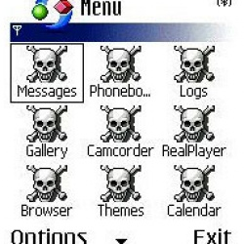


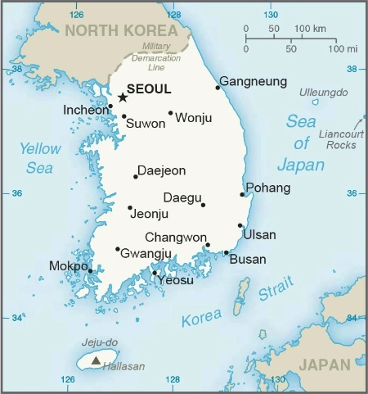
Overview
Nimda is one of the most dangerous and malicious malware that ever took place. It spread through the internet rapidly and is now known as the fastest propagating computer virus.
It was released on the September 18, 2001.
There were multiple creators/inventors of Nimda. One of them is serving time in prison.
It is said that the attacks took place in 15 different countries and the first one was South Korea. Also it is believed to have been created in China when this piece of evidence came up
"Concept Virus(CV) V.5, Copyright(C)2001 R.P.China"
Nimda is a Worm

Slide 4


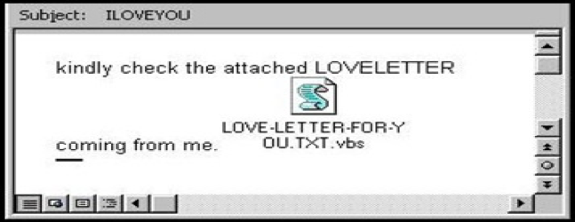
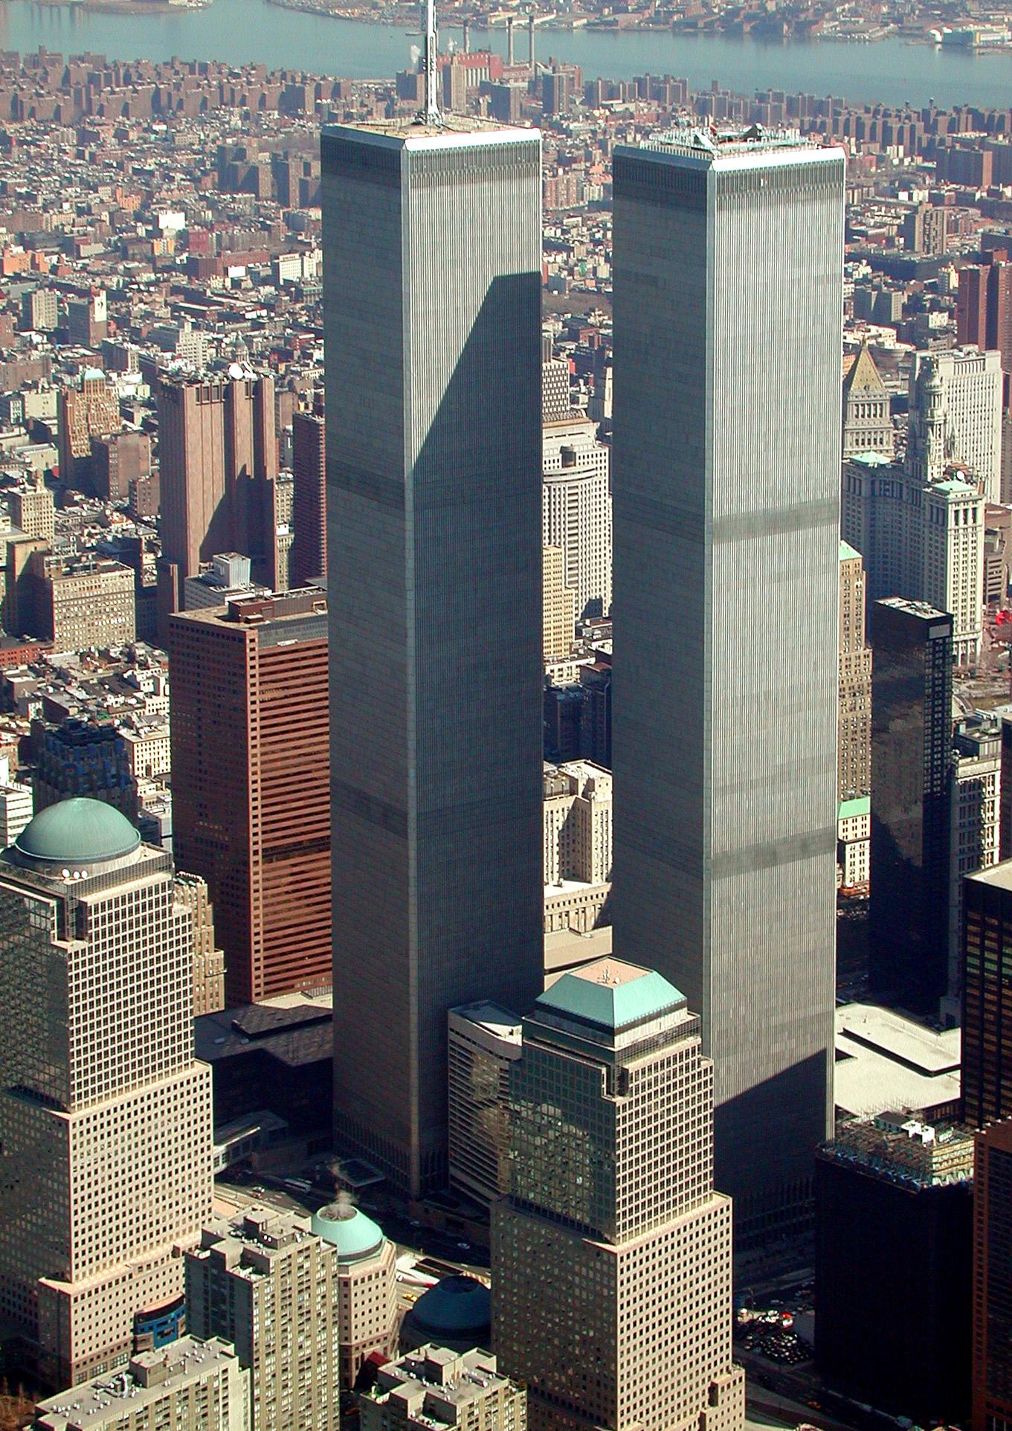
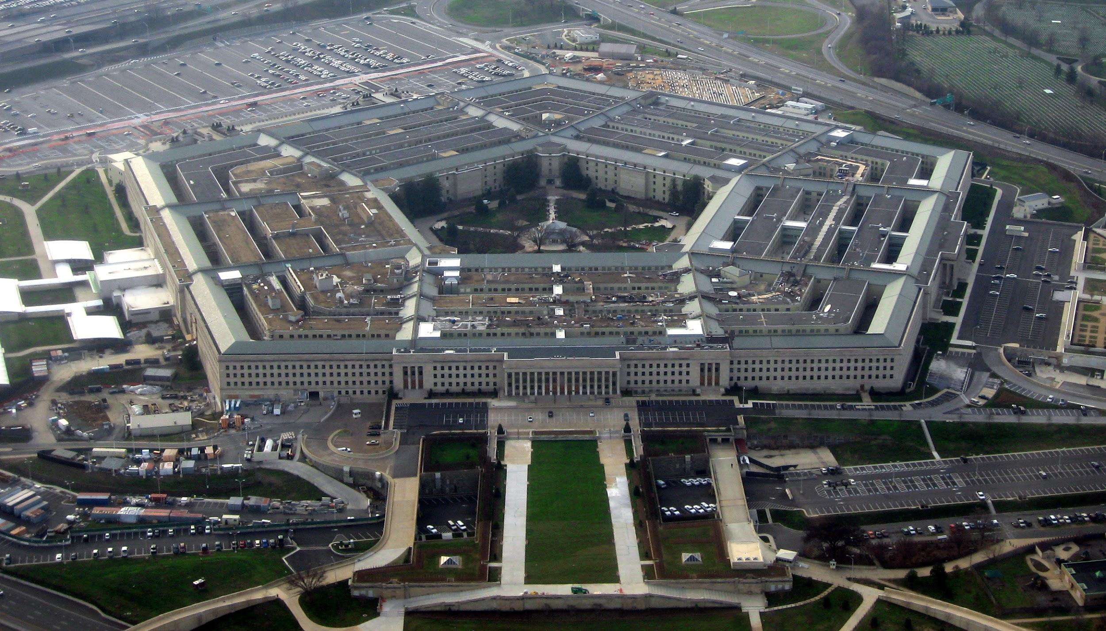
(Fun) Facts
Nimda is spelled “Admin” backwards.
Nimda appears to combine the worst characteristics of Code Red Virus and those of "I Love You," "Melissa" and other e-mail viruses that have plagued PC users for the past couple of years.
Over 2.2 millions PCs and servers were infected by this virus
This worm was launched just a week after the terrorist attack on the World Trade Center and the Pentagon

Slide 5

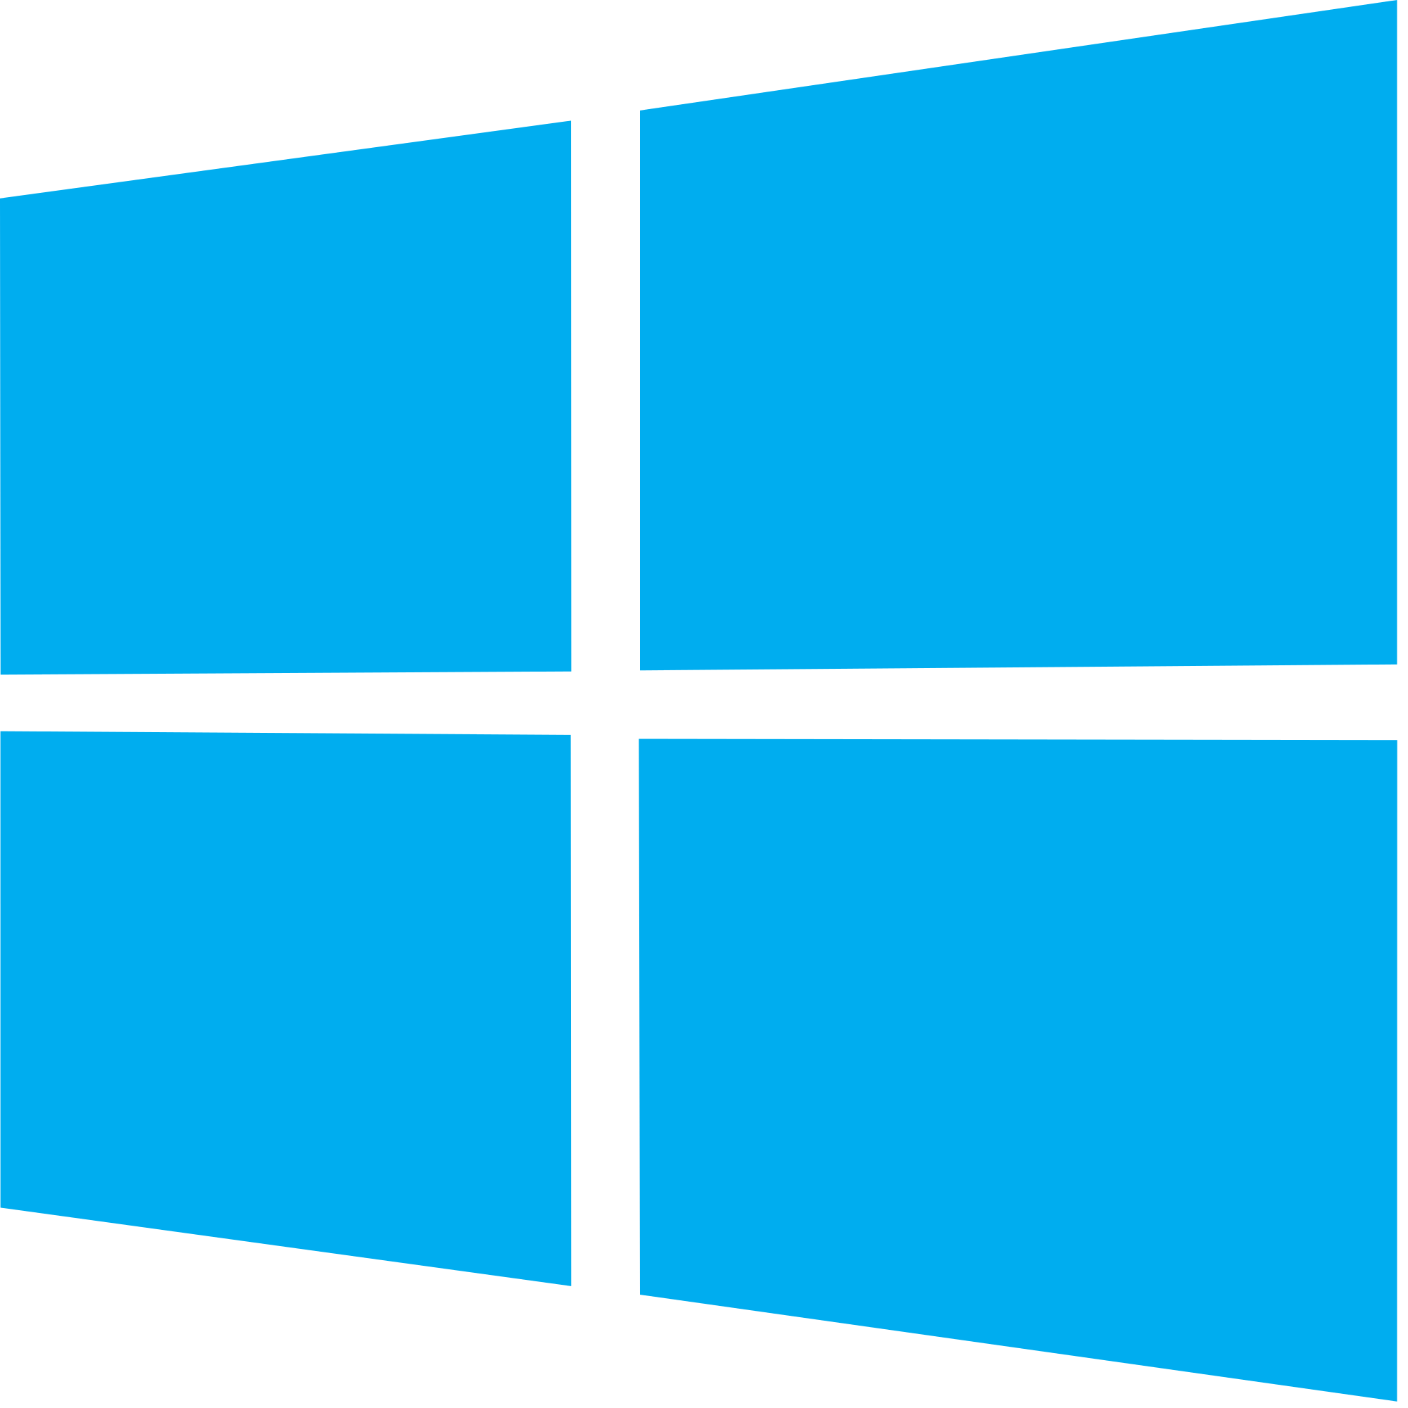

Hardwares: Microsoft PCs
Operating Systems: Windows 95 - XP
Softwares: Yahoo, and other servers
Target

Slide 6

“The Nimda virus does not hurt computer hardware, but clogs Internet traffic and e-mail access with junk, slowing them considerably.”
CBS News
The real purpose of Nimda was to slow down the internet traffic until the virus crashed many network systems.
So it did no harm to the PCs or the data stored on the Computer.
What It Did

Slide 7
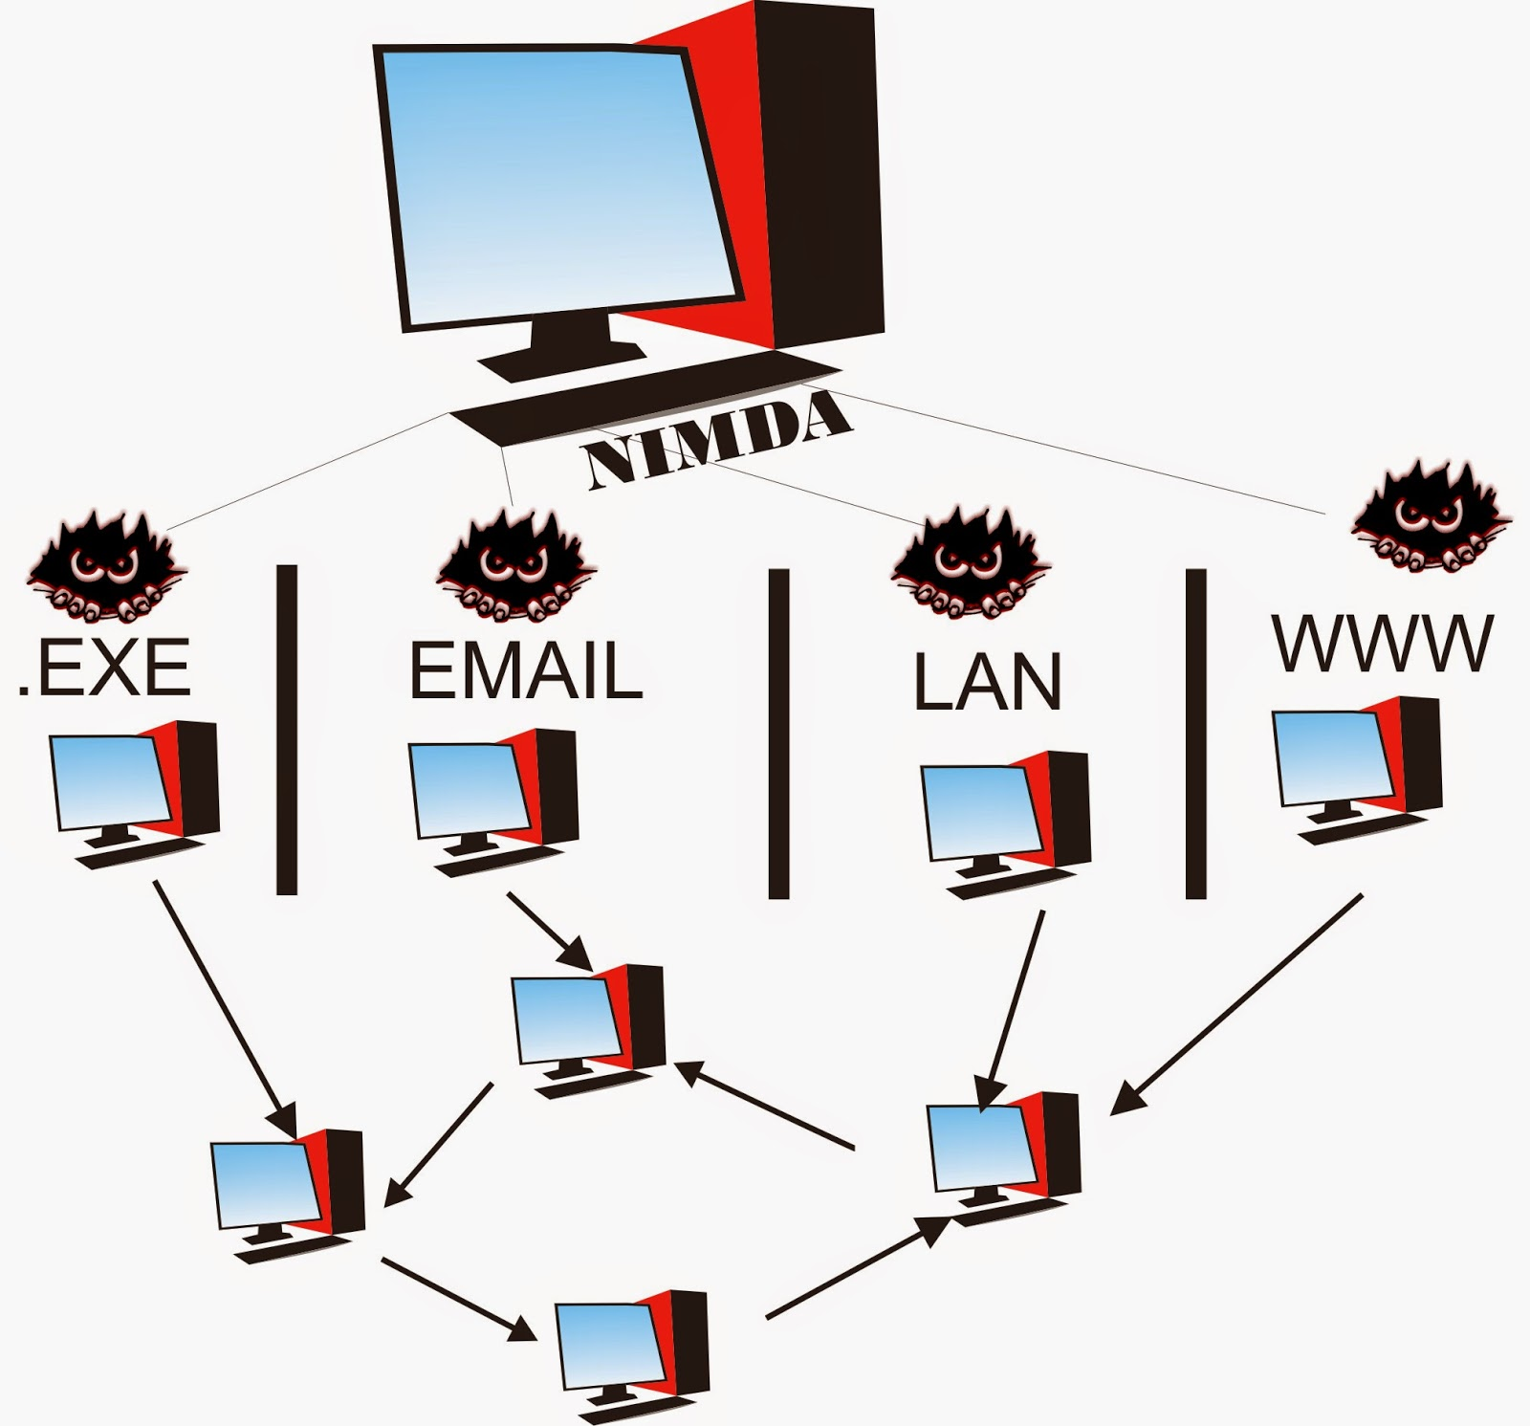
Nimda had 4 ways to successfully to become the web’s most widespread virus in 22 minutes. The 4 ways were:
Email
LAN
WWW
.EXE
Email users would receive email that were named as “README.EXE”
Nimda e-mails itself to all of the addresses in a user's address book and searches caches to find further addresses.
However Nimda virus was mostly caught on the internet.
How It Worked

Slide 8

Nimda is considered as one of the most dangerous virus in history for having caused $635 million worthy of damage.
Many network systems crashed after the outbreak of Nimda and this might have caused several people to lose several data stored on their computer
$635
Million
Its Effects

Slide 9

Its Control
Discovery
Nimda was discovered at around 9 a.m. when multiple complaints about internet slowdowns have been filled. To add, it has been discovered by a security expert from TruSecure
Stop
Since the only computers affected by Nimda virus, Microsoft stopped the virus by patching it one month after the outbreak
Removal Method
Disconnect System from the Network
Apply the patch provided by the PC
Close any network shares prior to cleaning
Exit any running applications
Stop IIS (Internet Information Services) Server
Install/Use Viruscan and update to latest DAT (Virus Database) files
Scan and clean each drive
Restore the RICHED20.DLL and MMC.EXE files

Slide 11
What It Did
https://searchsecurity.techtarget.com/definition/Nimda
https://www.cbsnews.com/news/a-worm-named-nimda/
http://www.domstechblog.com/deadly-viruses-101-worst-computer-viruses-time/
How It Worked
https://www.complex.com/pop-culture/2014/04/10-viruses-that-nearly-broke-the-internet/nimda
https://www.extremetech.com/extreme/57926-nimda-worm-virus-takes-over-the-net
https://www.cbsnews.com/news/a-worm-named-nimda/
Effects
https://www.investopedia.com/financial-edge/0512/10-of-the-most-costly-computer-viruses-of-all-time.aspx
https://computer.howstuffworks.com/internet/basics/internet-collapse.htm
Its Control
https://www.extremetech.com/extreme/57926-nimda-worm-virus-takes-over-the-net
https://www.theregister.co.uk/2011/09/17/nimda_anniversary/
https://vannevar.ece.uw.edu/computing/faq/virus/nimda.html
Citations
Overview
https://malware.wikia.org/wiki/Nimda
https://en.wikipedia.org/wiki/Nimda
https://www.computerweekly.com/news/2240042500/Nimda-worm-costs-firms-dear
https://www.cbsnews.com/news/a-worm-named-nimda/
Facts
https://www.computerweekly.com/news/2240042500/Nimda
-worm-costs-firms-dear
https://www.cbsnews.com/news/a-worm-named-nimda/
https://www.complex.com/pop-culture/2014/04/10-viruses-that-nearly-broke-the-internet/nimda
Target
http://lowendmac.com/virus/nimda.html
https://en.wikipedia.org/wiki/Nimda
https://www.cbsnews.com/news/a-worm-named-nimda/

